Slide 1

ELECTRA ENTERPRISES PUNE

Slide 2
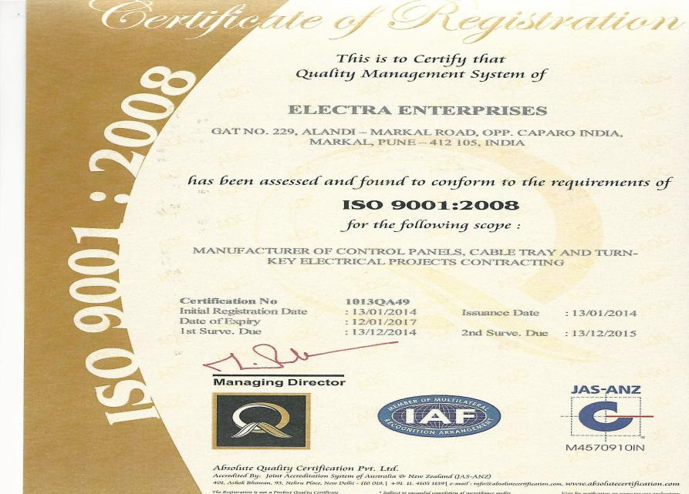

Slide 3
ABOUT ELECTRA ENTERPRISES
Electra Enterprises is a family-owned and operated company with an excellent record of success. Since 1986, we have consistently demonstrated a level of integrity and stability that has led to many continuing relationships with clients who appreciate our reliable and timely completion of projects, and our leadership.
Electra Enterprises has emerged as a pacesetter and a Leader in the Electrical Construction &
Maintenance field since industry realized that a single source turnkey electrical group has proved to be the cost-effective approach to reliable plant operation.

Slide 4
OUR ACTIVITIES INCLUDE:
Supply, Installation, Testing and Commissioning of
1) Indoor and outdoor substations
including structures, circuit breakers, isolators.
2) Installation, Testing & Commissioning
of transformers and diesel generator sets.
3) Heavy machineries like breaker panels,
PCC (Power Control Centre) Panels,
MCC (Motor Control Centre) Panels.
4) Cable trays with respective supports, HT/LT cable laying and Termination.

Slide 5
OUR PRODUCTS
We manufacture various types of panels with internal wiring. The same are as under
PCC Panels up to 6300A
MCC Panels
APFC & RTPFC Panels
AMF Control Panels
Street Light DB Panels
MLDB, LDB and Plug Socket DB

Slide 6
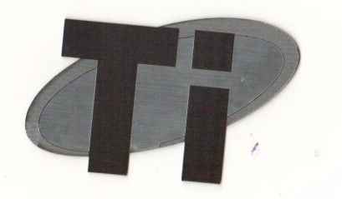
OUR PANELS ARE CPRI APPROVED
We are System Integrators of L&T for manufacturing of Ti Panels as per IEC – 61439 Part I & II

Slide 7
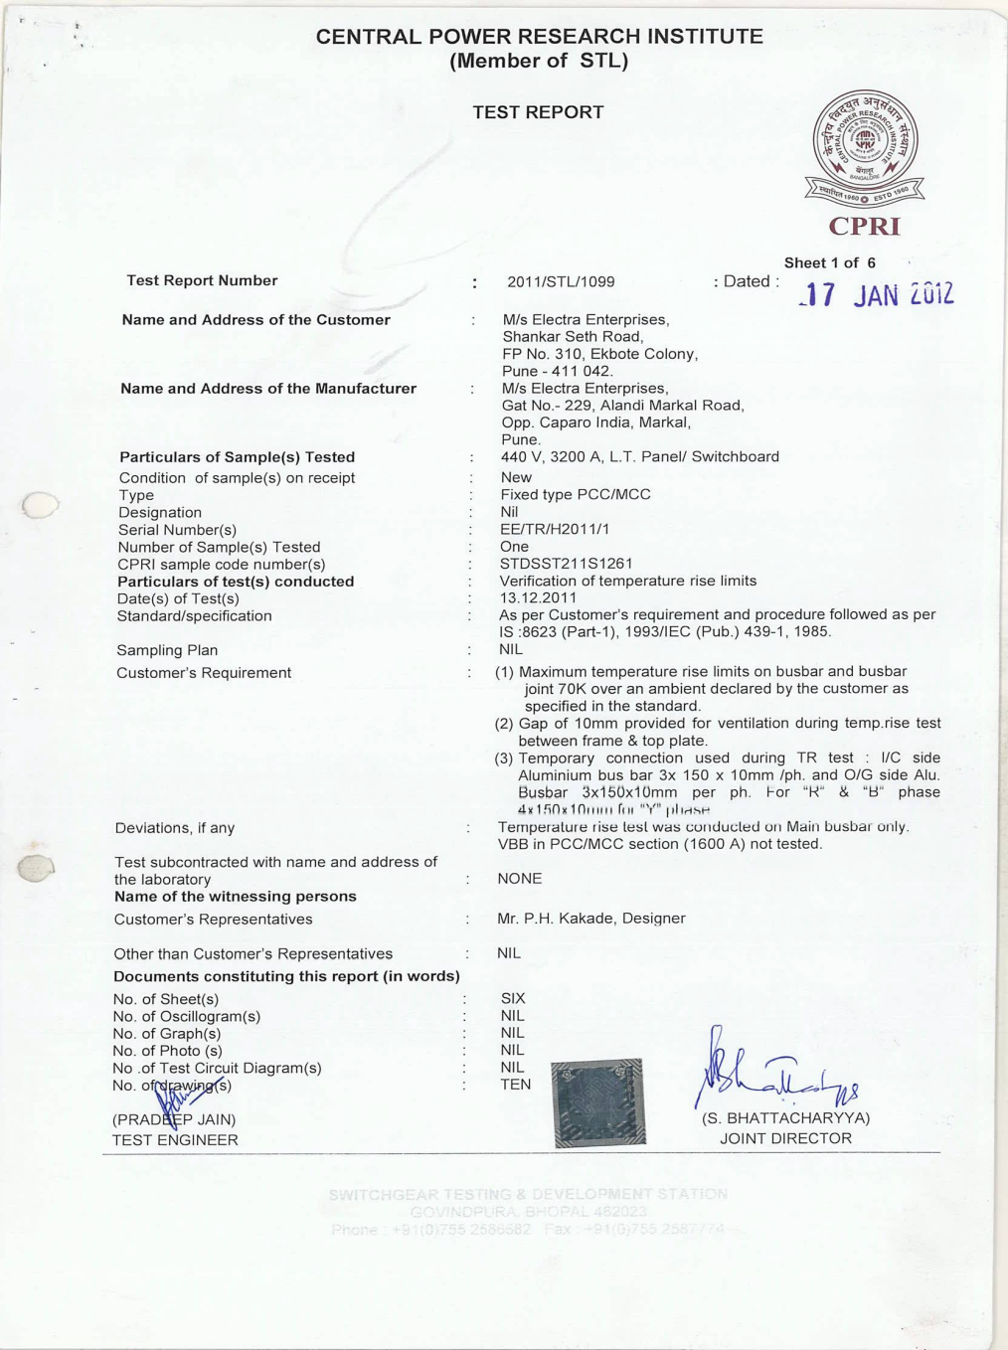
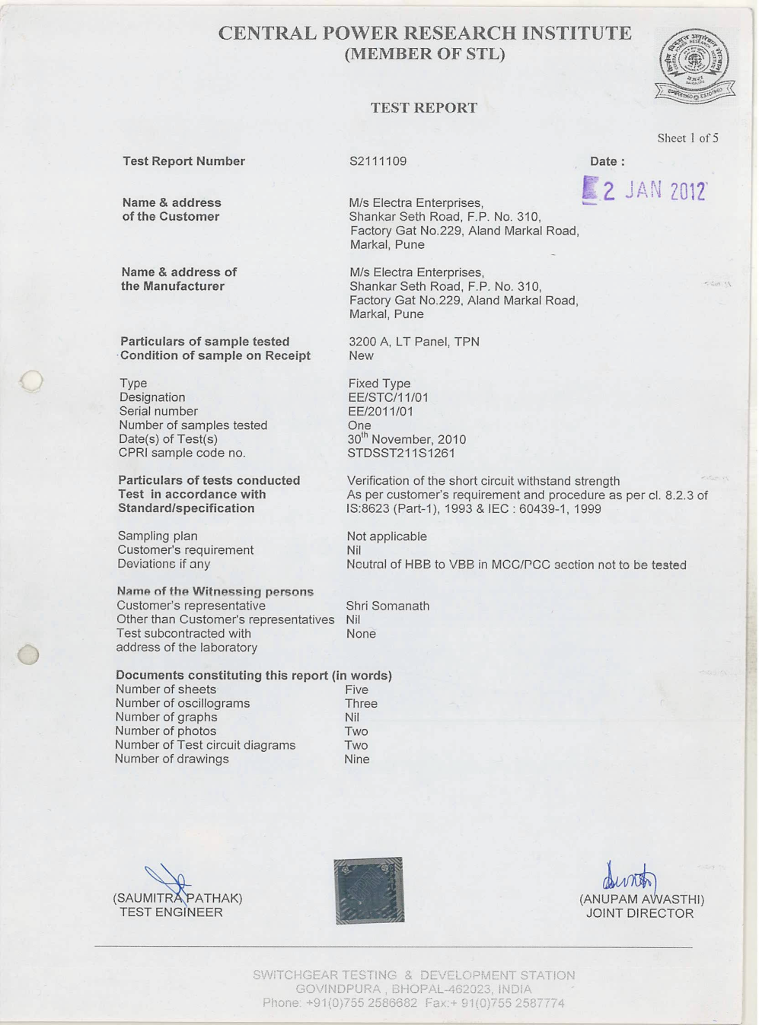
CPRI TEST CERTIFICATE

Slide 9
OUR PRODUCTS
We are into manufacturing of different types of cable trays and raceways. The same are as under
Cable trays (Ladder/Perforated/Wire mesh) and accessories of cable trays.
Junction Boxes
Earthing Material
We are manufacturing partner of NIEDAX Cable Management S y s t e m s , G e r m a n y for manufacturing and supply of different types of cable trays for Indian market.

Slide 10
PROJECT METHODOLOGY
Detailed Design Phase. a) functional specification
b) design review & approval
c)detailed engineering
2. Material & Stock Planning
3.Manufacturing & Testing.
a) manufacturing
b) integrated testing c) factory acceptance

Slide 11
4. Commissioning & deployment
a) on site commissioning b)site acceptance test
c) training
5. Post Implementation
a) support
b) Continuous Improvement

Slide 12
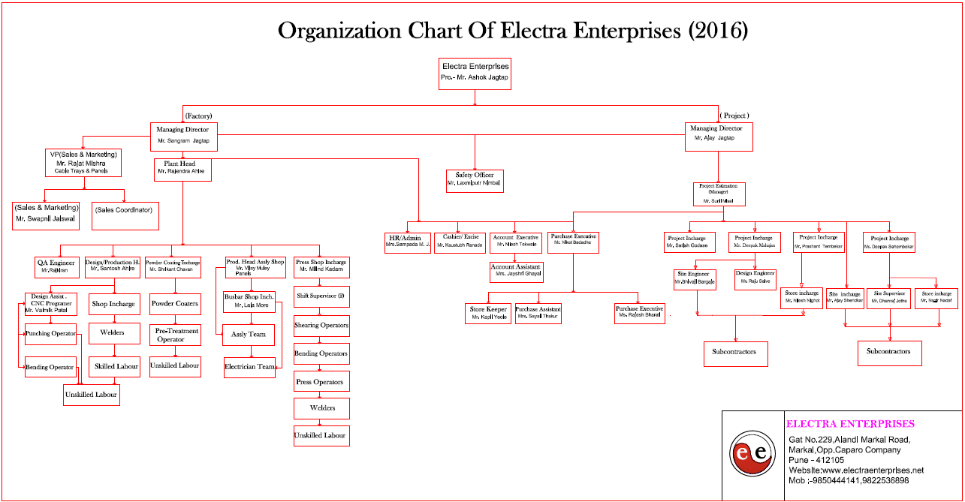

Slide 13
MAJOR PROJECTS UNDER EXECUTION
Sr.No. | Name of Client | Nature of Work | Amount
1 | NATRIP, Pithampur, MP | Installation ,Testing Commissioning & Liaisoning 3MVA Transformer,HT,LT Electrical work,Panel & Street Light . | 5.50 Cr.
2 | The Automotive Research Association Of India (ARAI), Ph 1 & 2, Chakan MIDC, Pune | Supply installation , testing, commissioning & Liaisoning (4000kva X 2) Transformer, LT internal & External electrical work, 4000 A LT Panel, 4000 A, 2500A BUS duct, turnkey electrification. | 14.00 Cr.
3 | Trend India | Trunkey Internal electrical Work | 0.65 Cr.
4 | Porite India Chakan Midc | Supply, Installation, Testing & commissioning 2500 KVA Transformer with 4000A Busduct,Panel,Lighting , turnkey HT,LT internal & external electrical work. | 1.90 cr.

Slide 14
MAJOR PROJECTS COMPLETED
Sr.No. | Name of Client | Nature of Work |  | Amount
1) | HUF India (Ph 2) Chakan | Supply, installation testing commissioning of HT panel transformer ,Supply of Main LT panel, power panels lighting panels ,shed lighting street lighting , ( Turnkey Electrical project ) | Completed | 9 cr.
2) | Lear Automotive PVT LTD. Chakan MIDC Pune. | Supply, installation testing commissioning of HT & LT electrical work transformer ,Supply of Main LT panel, power panels lighting panels ,shed lighting street lighting , ( Turnkey Electrical project ) | Completed | 8.16 Cr
3) | Tacle Automotives India Pvt Ltd. Plot no RNS – 4 Renault Nissan supplier Sriperumbuder TK Tamilnadu 603109 | Approval from TNEB installation of HT panel transformer ,Supply of Main LT panel, power panels lighting panels ,shed lighting street lighting , ( Turnkey Electrical project ) | Completed | 2.50 Cr

Slide 15
Sr.No. | Name of Client | Nature of Work |  | Amount
4) | Mahindra Forgings Ltd. Chakan – Ambethan road , Chakan MIDC, Pune ( MCD DIV ) | Installation of 2.5 MVA transformer, supply of 4000 A beaker panels, installation of 630 A sandwich type bus trunking system, 40 tons of fabrication, supply and installation of earthing material , supply of cables and cable trays as per design, installation of HT substation | Completed | 2.10 Cr
5) | Jupiter Hospital Baner | Approval from TNEB installation of 3000 kva Transformer HT panel transformer ,Supply of Main LT panel, power panels lighting panels ,lighting,street lighting , ( Turnkey Electrical project | Completed | 2.36 Cr.
6) | Danobat Grupo Machine Tool India Pvt. Ltd. Shirwal | Turn Key Industrial Project (Including supply of panels & cable trays with supports etc) | Completed | 3.17Cr.
7) | Philips India Limited.Chakan MIDC, Pune | Entire supply installation, testing & commissioning HT ,LT Electrical work including plant panel distribution,Transformar and illumination at chakan plant, | Completed | 2.23Cr
8) | Harman International India Pvt Ltd | Turn Key Industrial Project ( supply testing commissioning of internal & external work, Panel,lighting. | Completed | 3.10Cr.

Slide 16
Sr.No. | Name of Client | Nature of Work |  | Amount
9) | Bharat Gears Ltd Lonand MIDC, | Turnkey Electrification with material (Including supply of panels & cable trays with supports etc) | Completed | 2.38 Cr.
10) | HUF India (Ph 1) Chakan MIDC, Pune | Electrification + Industrial PProject ((Including supply of panels & cable trays with supports etc) | Completed | 2.10Cr
11) | PMP Drive Chakan Midc Pune. | Approval from TNEB installation of HT panel transformer ,Supply of Main LT panel, power panels lighting panels ,shed lighting street lighting , ( Turnkey Electrical project ) | Completed | 2.00 Cr
12) | Philips India Limited.Chakan MIDC, Pune | Entire supply installation, testing & commissioning HT ,LT Electrical work including plant panel distribution,Transformar and illumination at chakan plant, | Completed | 2.23Cr
13 | JSW | Approval from TNEB installation of transformer ,Supply of Main LT panel, power panels lighting panels ,shed lighting street lighting , ( Turnkey Electrical project ) | Completed | 2.5Cr
14) | MHYCO Seeds Ltd. Aurangabad Jalana road ,Jalana | Installation of 2 nos 2.5 MVA transformer, HT breaker ,metering equipment. SITC of main 6000 A ACB panel , sub-main panels, supply of various size of cable trays along with necessary fabrication work supply and laying cables etc. | Completed | 1.50 CR

Slide 17
Some Esteemed Industrial Projects
a) ARAI, Chakan, Pune
b)JSW, Rajgurunagar, Pune
c)NATRIP, Pithampur (MP)
d)Shimizu Corporation India Pvt Ltd Chakan Pune.
e)HUF INDIA PVT. LTD. (Ph 1 & Ph 2) Chakan, Pune
f) PHILIPS INDIA LTD. (Health Care Div.) Chakan, Pune
g) POSCO Steel, Raigad, Maharashtra
h) LEAR AUTOMOTIVES LTD.
(Pune – Bhosari & Chakan Plant)
Contd..
OUR VALUED CUSTOMERS

Slide 18
OUR VALUED CUSTOMERS
.
i) FORBES MARSHALL LTD. Pune
j) Harman International India Pvt Ltd. Chakan, Khed,
Pune
k) BHARAT GEARS LTD. Lonand MIDC, Pune
l) Mahindra Gears & Transmission Ltd. Chakan, Pune
m) PMP Drive Systems India Pvt Ltd, Khed, Pune
n) Linhoff India Pvt Ltd, Pune
o) Tacle Automotives India Pvt. Ltd. Tamilnadu
p) Garware Bestretch Limited, Wai, Dist: Satara

Slide 19
OUR VALUED CUSTOMERS
q) Neosym Industries Ltd , Sanaswadi, Pune
r) Amtek Auto, Sanaswadi, Pune
s) Mahindra Forgings Ltd. Chakan, Pune
t) SONA ALLOYS LTD., Lonand MIDC, Pune
u) I.S.R.C (Information System Resource Centre)
Pune.
v) Bedmutha Industries Ltd, Dhule

Slide 20


















Slide 21
We are proudly associated with
1) Abhiyanta Electrical Consultants & Engineers, Pune
2) Shimizu Corporation Bengaluru.
3) Tata Consultaning Engineers, Pune
4) Gherzi Eastern Ltd. Mumbai
5) Archivista Engineering Projects Pvt. Ltd., Pune
6) Apt Samruddhi Engineering Consultants, Pune
7) Vidyut Sallagar Electrical Consultants & Engrs, Pune
8) Electromech Engineers, Pune
9) Unique Consultancy Services, Pune
10) Manas Consultants, Mumbai
11) Archicon Associates, Pune
12) Prashant Deshmukh & Associates, Pune
13) Jayam Consultants, Chennai ( Chennai Project)
14) Delta Interiors
15) Safal Engineers, Pune

Slide 22
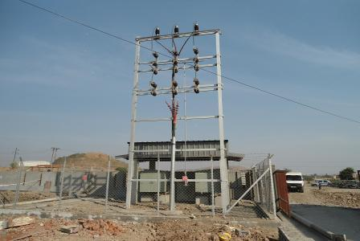
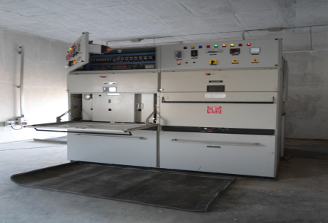
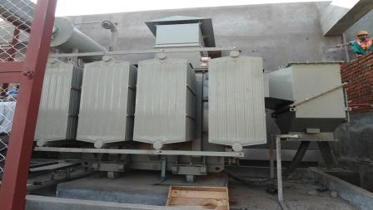
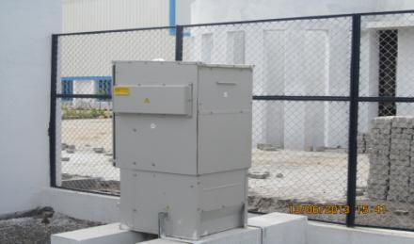
Recently Completed Site: 33 KV sub station

Slide 23
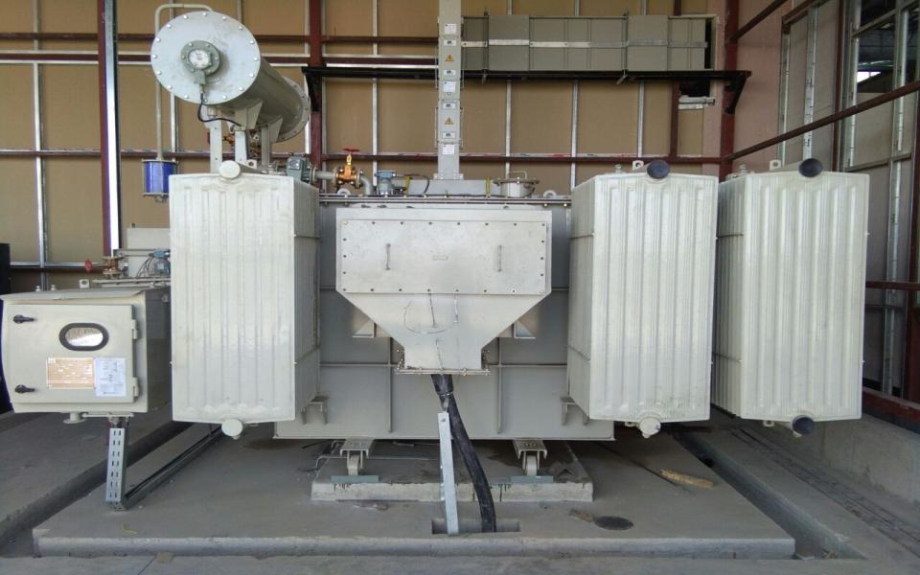
22 KV TRANSFORMER WITH 4000A BUSDUCT INSTALLATION

Slide 24
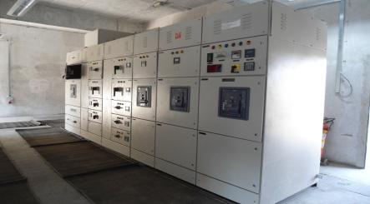
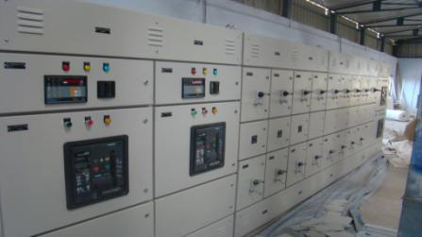
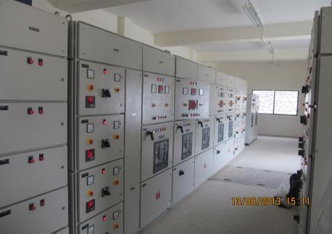
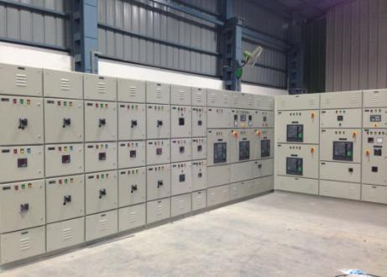
LT BREAKER PANEL

Slide 25
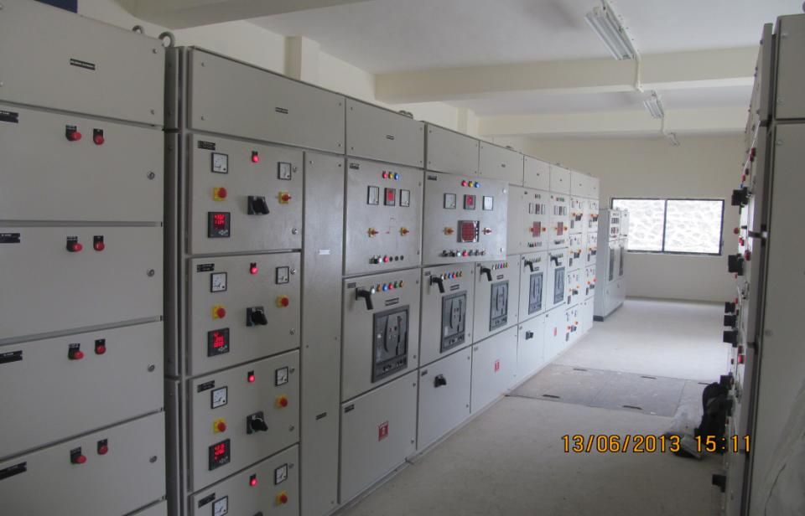
Installation of Main LT Breaker panel

Slide 26
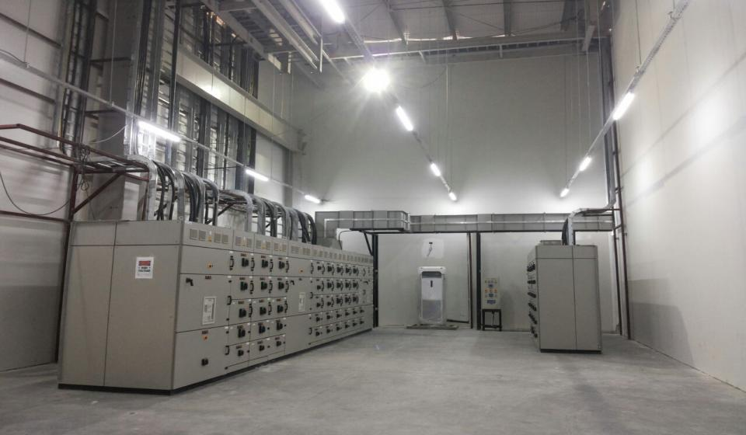
Main LT Panel with Busbar Trunking at Porite India Chakan.

Slide 27
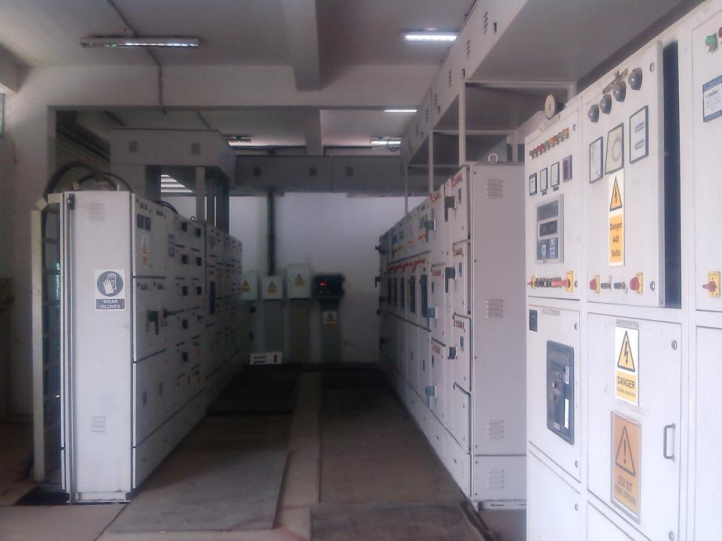

Slide 28
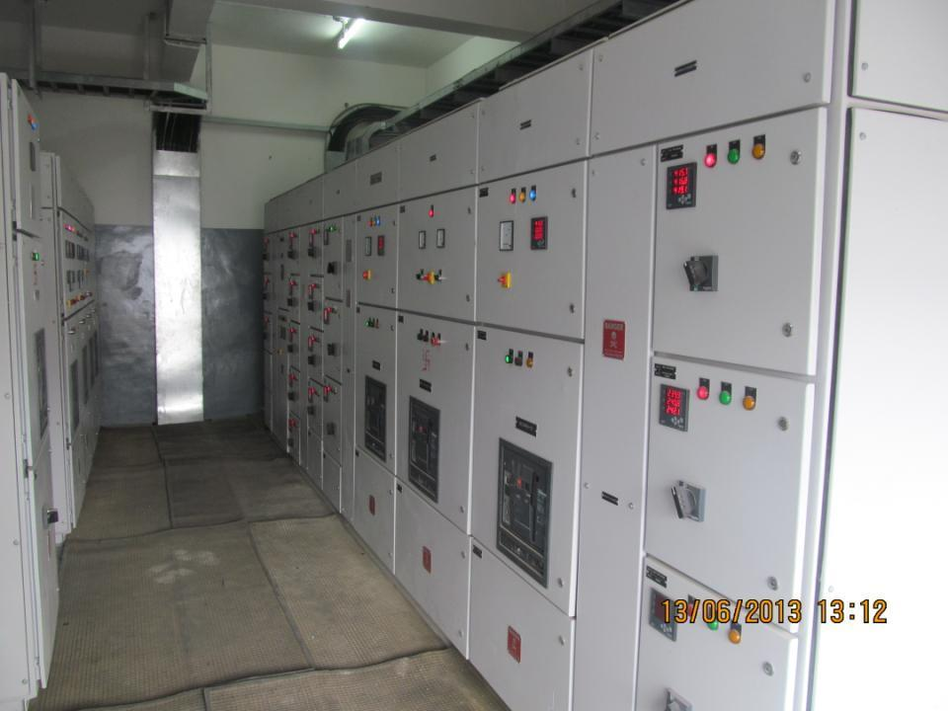

Slide 29
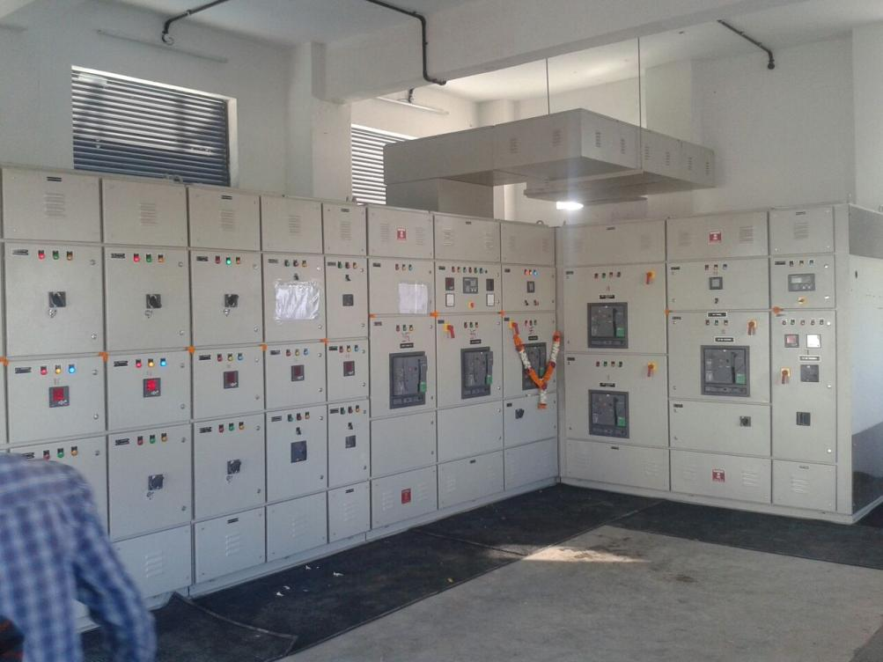

Slide 30
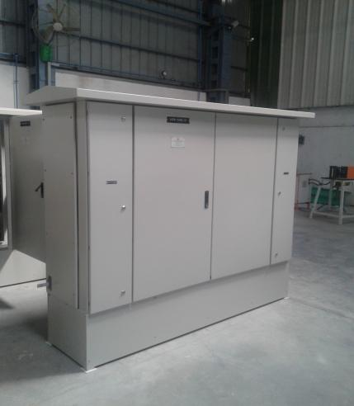
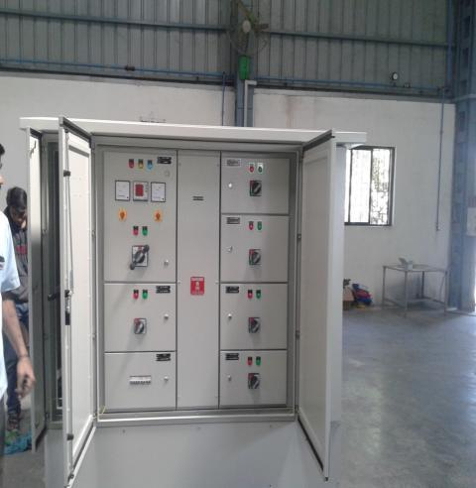
OUTDOOR INSTALLATION

Slide 31
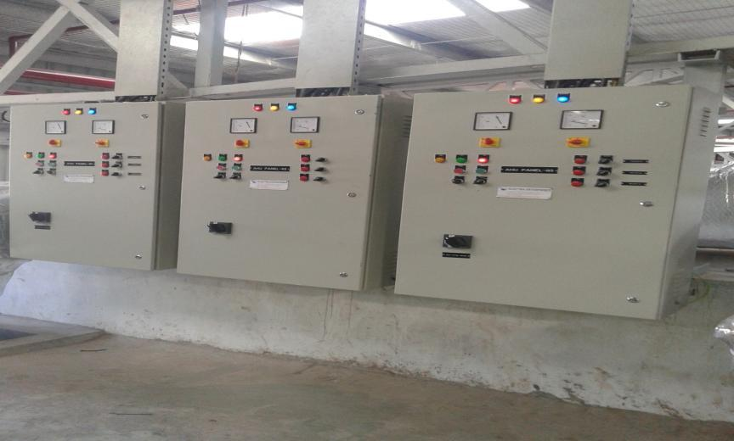
WALL MOUNTED AHU PANEL

Slide 32
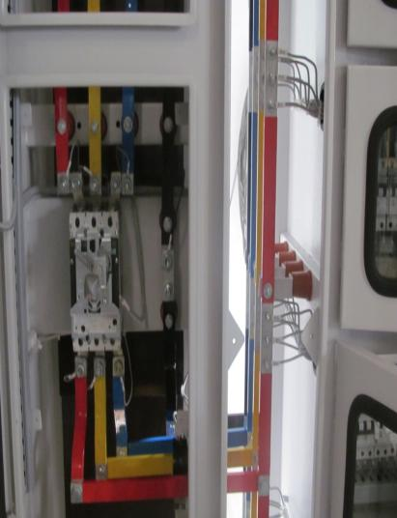
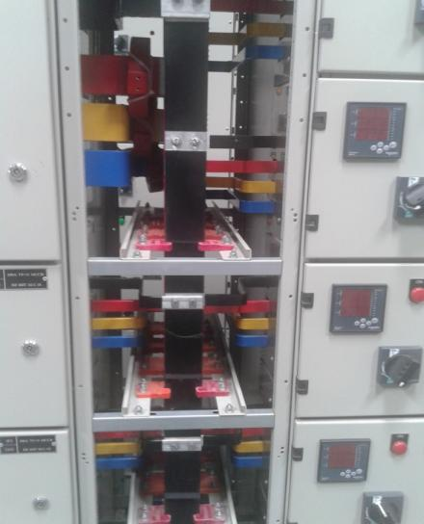
PANEL INTERNAL WIRING

Slide 33
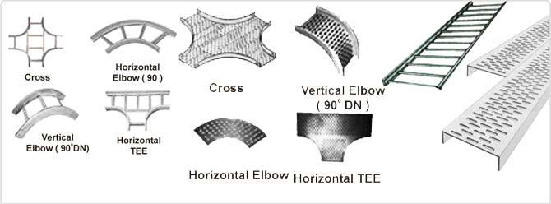
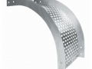
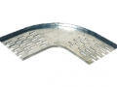
Cable Tray Manufacturing, Supply &
Installation
PERFORATED CABLE TRAY BENDS
CABLE TRAY BEND

Slide 34
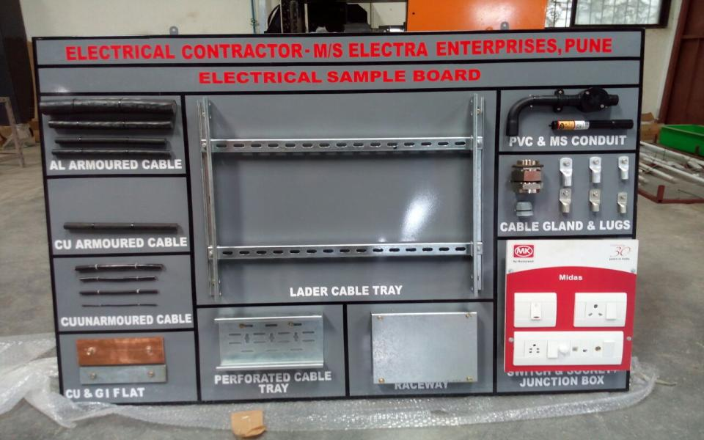
PRODUCT APPROVAL BOARD

Slide 35
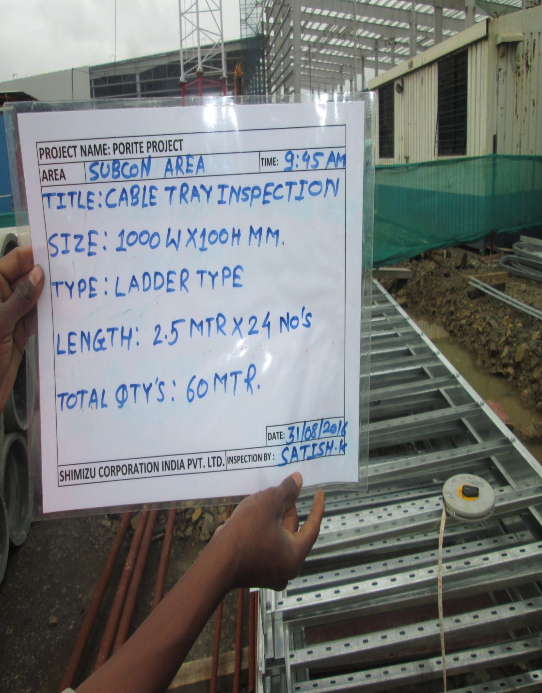
MATERIAL INSPECTION AT SITE.

Slide 36
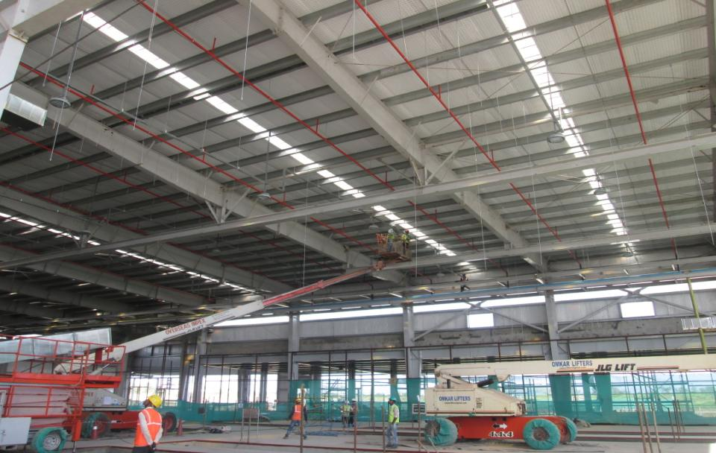
HEIGHT WORK WITH BOOM LIFT AT PORITE INDIA PVT. LTD. CHAKAN

Slide 37
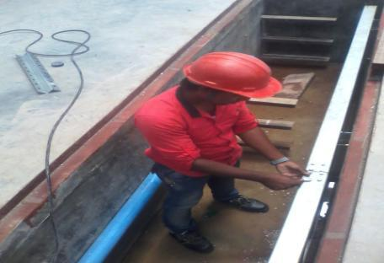
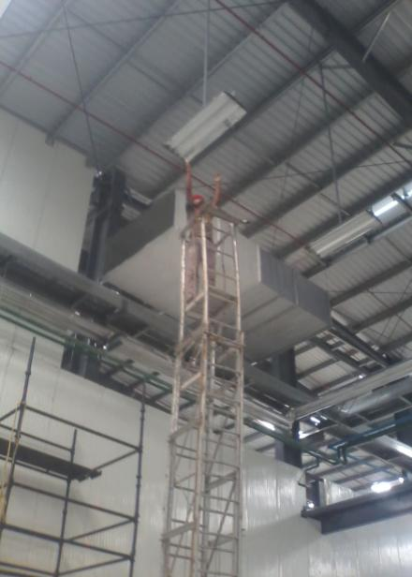
SITE WORK AT HUF INDIA PVT. LTD. CHAKAN

Slide 38
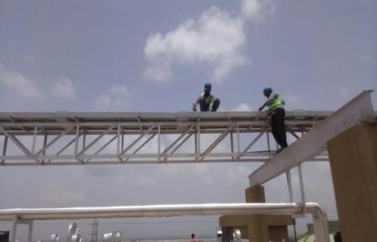
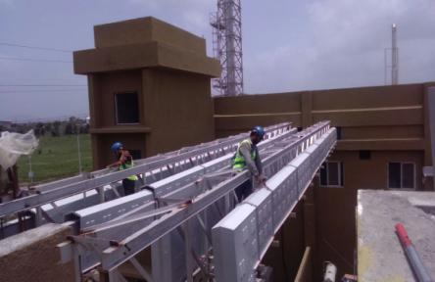
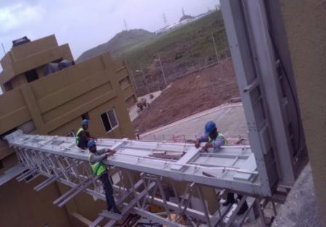
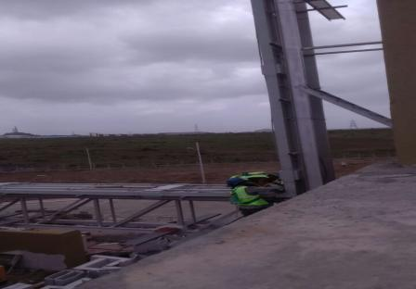
5000A BBT INSTALLATION AT ARAI, CHAKAN

Slide 39
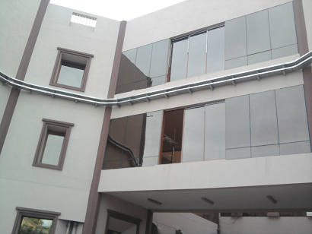
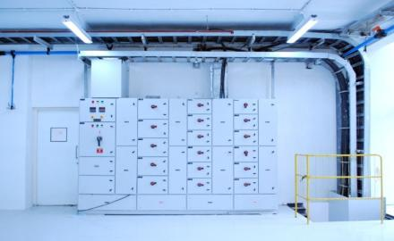
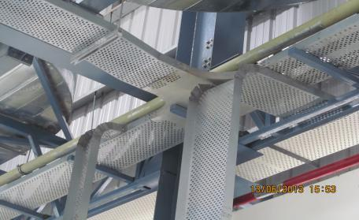
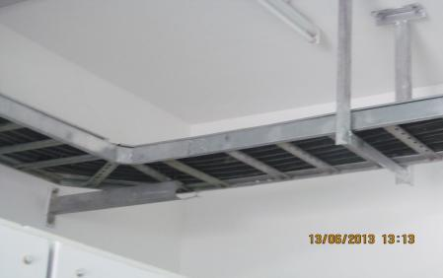
CABLE TRAY SUPPLY & INSTALLATION

Slide 40
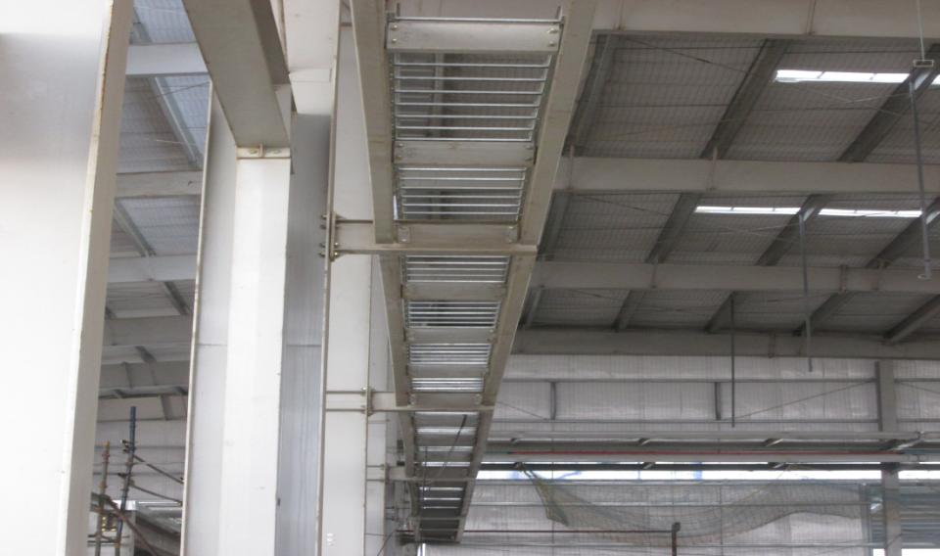
CABLE TRAY SUPPLY & INSTALLATION

Slide 41
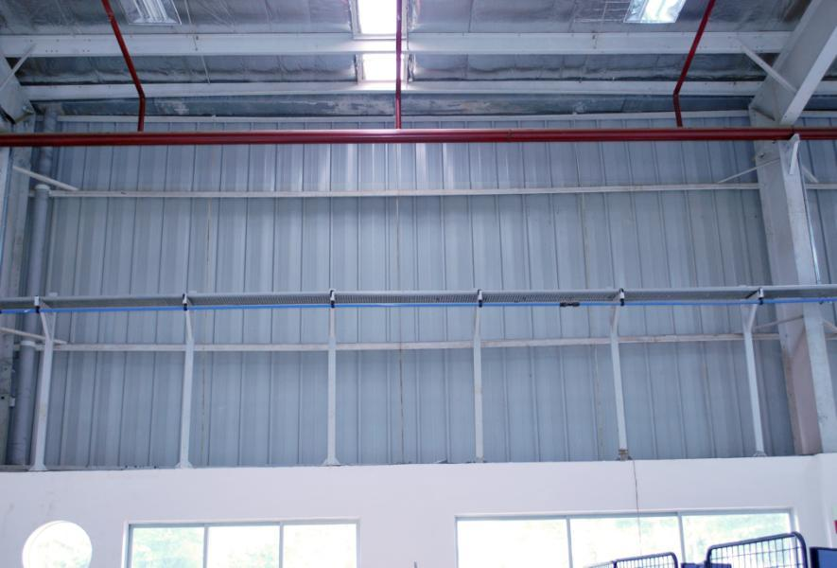
CABLE TRAY AND SUPPORTS

Slide 42
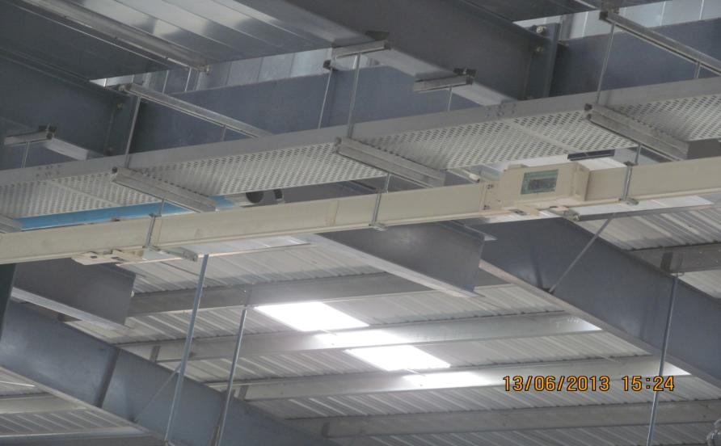
250 A AL BBT installation: Bharat Gears

Slide 43
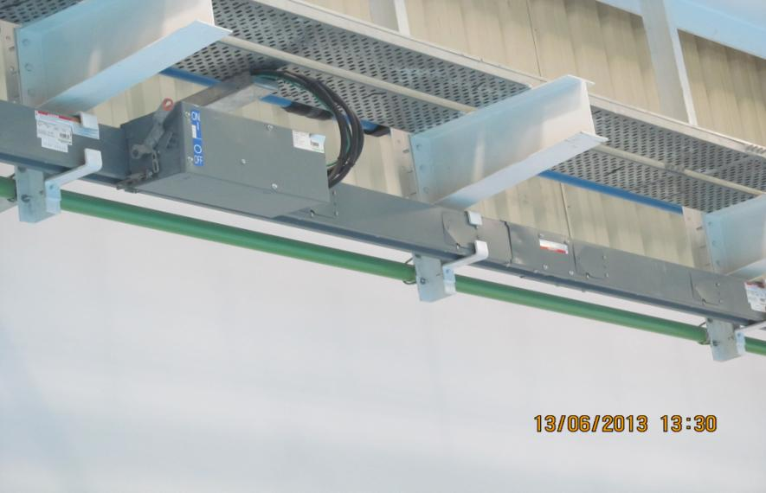
400 A AL BBT INSTALLATION :DGL

Slide 44
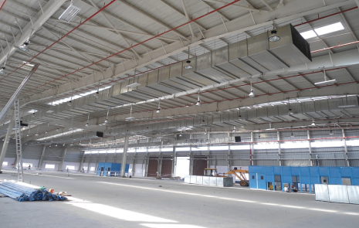
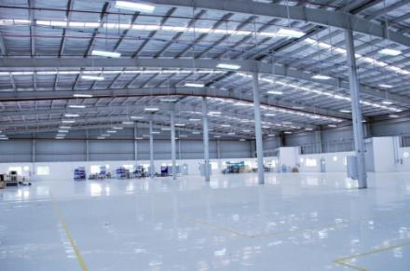
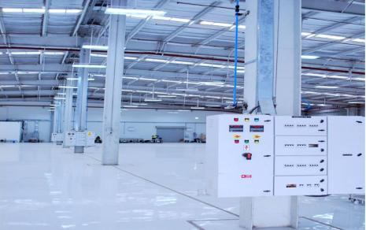
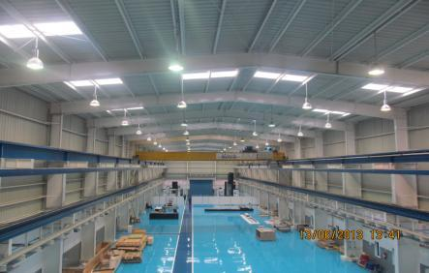
SHED LIGHTS WITH SUPPORTS SUPPLIED/INSTALLED :-PHILIPS / LEAR / DGL

Slide 45
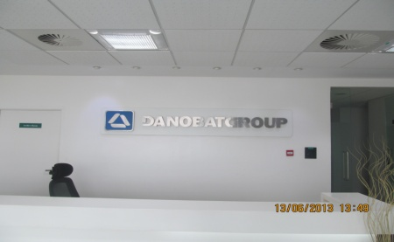
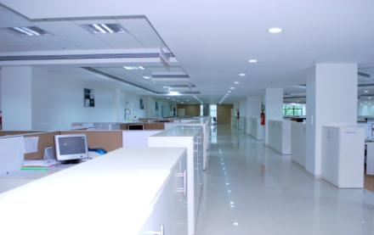


Office Illumination

Slide 46

Solar electrical hybrid street Light : PHILIPS

Slide 47

STREET LIGHT SUPPLIED / INSTALLED

Slide 48

ELECTRA factory at Markal MIDC, PUNE

Slide 49




WORK AT FACTORY

Slide 50

20 TON CNC TURRET PUNCH PRESS

Slide 51

Amada Make 100T CNC Bending Machine

Slide 52

7 Tank process facility

Slide 53

Fully Automatic Conveyorised Powder Coating Plant

Slide 54
THANK YOU

